Slide 1
Game Theory in Adversarial Search
And its application to backgammon

Slide 2
Introduction
What is AI?
Agents
Rational Agents
Environments
Multiagent competitive environment
Games
Game Theory
Agents = players
Environment = state
Notes:
Artificial intelligence is the field of understanding how we think and how to build intelligent entities. Definitions of AI is broken up into four categories: Thinking humanly, Acting Humanly, Thinking Rationally, and Acting Rationally.

Slide 3
Introduction
Most are turn-taking, two-player, zero-sum games of perfect information
Picture her: tic-tac toe.
Notes:
Most AI games are …

Slide 4
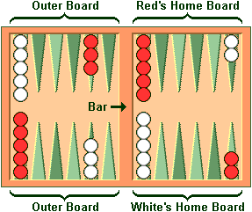
The project
Apply game theory to an AI for backgammon
Backgammon Intro:
Goal: remove all your checkers from board
talk

Slide 5
Game Formulation
Turn-taking, two-player, zero-sum game with perfect information
Players: 2 players (AI and Human)
Strategies: Actions (set of checker moves based on dice roll)
Utility: -1 (Lose), 0 (Tie), 1 (Win)
Is it deterministic?
NOOOOOOO

Slide 6
Stochastic Games
Stochastic games vs. deterministic games:
(pic here)

Slide 7
Nash Equilibrium
We theoretically could backtrack… but
21 possible rolls with 2 dice
Given the dice roll, ≈ 20 legal moves on average
depth 4 = 20×(21×20)3 ≈ 1.2×109
Computationally expensive!!
So what now?

Slide 8
Approaches/Past work
Approaches
Monte Carlo pruning
Minimax pruning
Past Work
Reinforcement learning with neural networks
TDGammon
BKG program

Slide 9
What now?
What we have done:
Enumerating legal plays
What we need to do:
Introduce the evaluation function
Set up the AI

